Slide 1
SPM Version 3 to Version 4 changes
Author: Kailash Upadhyay
Email: Kailash@addonskills.com
WhatsApp: +91-9820845035

Slide 2
Summary
This fourth edition very clearly says no significant changes between Third and Fourth edition. I 100% agree to this statement after my first review of fourth edition.
The standard continues to shift closure to principle-base versus process based.
So, PgMP aspirant who are currently studying or undergoing training or purchased some of the study material from market need not worry to much.
I also don’t think it’s too much effort for trainer and/or authors to revised their training material or books or question banks, etc.,
I also don’t think PMI is changing their PgMP-ECO (Exam Content Outline). So if your PgMP course material is aligned to it then absolutely need not to worry.

Slide 3
SPM 4th Edition: Chapter 1
Absorbed key content from the SPM 3rd Edition, Appendix X3: categorization of programs (Strategic, Compliance Emergent) and program manager competencies.
Expanded the introduction to critical roles: program manager, program sponsor and program management office.
Program component are now termed as projects, subsidiary program and other program-related activities.
Subprograms component are now referred as “Subsidiary” program and very good example given at page no. 4.
Other work component are now referred as “program-related activities”
Program Preparation sub-phase of Program Definition phase, now referred as “Program Planning” sub-phase. Refer Diagram 1-1. Program Life Cycle at page # 5.

Slide 4
SPM 4th Edition: Chapter 2
This Chapter has minor changes as follows.
Added a subsection on program complexity and interdependency.
Shifted introduction of program life cycle phases into section 7.

Slide 5
SPM 4th Edition: Chapter 3
Program Mandate document has been removed from this 4th Edition.
Program Plan has also been removed from this 4th Edition. Good exclusion.
Program Charter now explicitly mentioned on this Program Strategy Alignment chapter.
Better Diagram 3-2. Program Roadmap example given
Happy to see section 3.5 Program Risk Management Strategy into this Chapter. Very valid inclusion.

Slide 6
SPM 4th Edition: Chapter 4
Least Changes but good changes in this Chapter.
Program Benefits Delivery phase, now referred as “Program Delivery” phase. Refer Diagram 4-1. Program Life Cycle and Program Benefits Life Cycle at page # 46.
First Bullet point under Benefits Analysis and Planning now changed from “Derive and prioritize components” to “Derive and prioritize Benefits”. Very good change.
Benefits Transition phase of Benefits Management now overlapping to Program Delivery phase. Refer Figure 4-1.
Benefits Sustainment phase of Benefits Management now overlapping to Program Closure phase. Refer Figure 4-1.
Benefits Realization Plan now termed as Benefits Management Plan.

Slide 7
SPM 4th Edition: Chapter 5
This Chapter has minor changes as follows.
Program Governance Board are now prominently termed as “Program Steering Committee”
Stakeholder analysis now become an Important Program Stakeholder activity and mentioned as Section 5.2. Good change.
Expanded to address program stakeholder mapping and program stakeholder communication. Refer section 5.5 at page # 66.

Slide 8
SPM 4th Edition: Chapter 6
This Chapter is now aligned PMI new Practice Guide on Governance – Governance of Portfolios, Programs and Projects.
Expanded to address the roles associated within program governance.
Exclusion of section 6.6 -- Governance activities that support Program Management such as PMO, PMIS, Knowledge Management, Program Management Audit Support and Program Management Education and Training . This have been moved to Chapter 8.
Section 6.1.6 Program Risk and Issue Governance defined clearly.
Section 6.1.7 Program Quality Governance defined clearly.
Section 6.1.8 Program Change Governance defined clearly.
Section 6.3 Program Governance Design and Implementation inclusion. Good one.

Slide 9
SPM 4th Edition: Chapter 7
Absorbed introduction to Program Life Cycle Phases
Relabeled “Program Preparation” sub-phase of Definition Phase to “Program Planning” sub-phase of Definition.
Relabeled “Program Benefits Delivery phase” to “Program Delivery phase”.
Added an introduction to program activities to map into Section 8.

Slide 10
SPM 4th Edition: Chapter 8
This section or chapter shifted away from “processes” to supporting “Program Activities.”
Next few slides explains all activities and their interaction with program lifecycle phases.
A major change to the structure of Section 8 occurred to help practitioners in mapping Section 3 through 7 with the content of Section 8. Program activities are now aligned to the program life cycle phases versus topics.

Slide 11
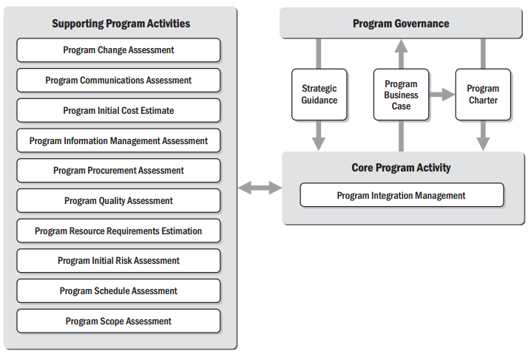
Figure 8-1 Program Formulation Sub-Phase Activity Interaction

Slide 12
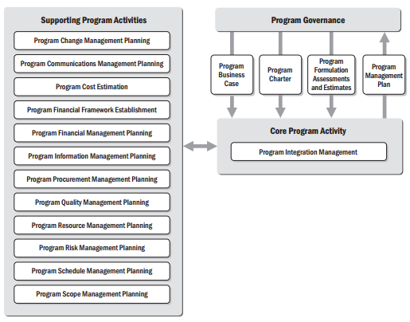
Figure 8-2 Program Planning Sub-Phase Activity Interaction

Slide 13
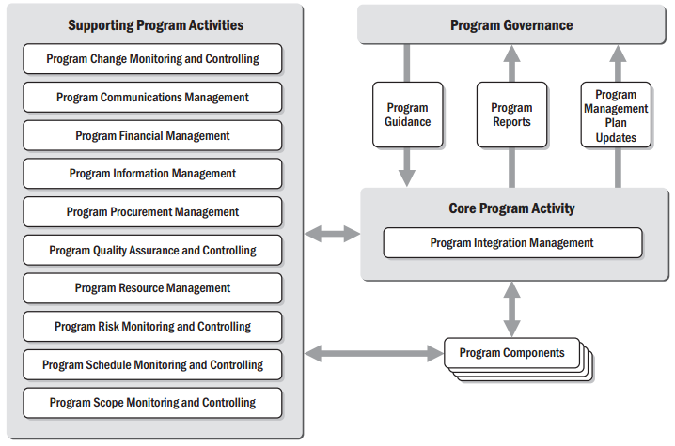
Figure 8-3 Program Delivery Phase Activity Interaction

Slide 14
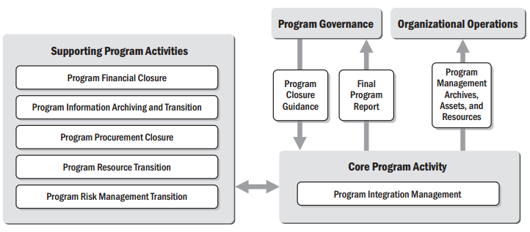
Figure 8-4 Program Closure Phase Activity Interaction

Slide 15
PgMP Journey in 2 Months & First Attempt
Pre-Requisite
Commitment.
Execution
SPMv3 Highlighted Section & Key points.
Week before Exam
Exam Tips & Tricks by Addon Skills.
Ego.
Right Training Partner.
QBank by Addon Skills.
Focus groups – Whatsapp.
Training from Addon Skills.
Q&A and Concept Understanding Virtual Session.
QBank by Addon Skills till I reached 80%
Extensively used Focus groups – Whatsapp for posting queries / doubts / questions.
Last week – read ECO, 3/4 times.
Key points Highlighted by Addon Skills on SPMv3.

Slide 16
PgMP Certification Training Calendar
Online Instructor-led certification course – Start 24th October to 30 November 2017
Classroom training at New Delhi – 28th (Sat), 29th (Sun) October and 5th (Sun) November
Classroom training at Mumbai – 28th (Sat), 29th (Sun) October and 5th (Sun) November

